Slide 1

PPT on
Credit Card Fraud Detection
Submitted by
Pragati Dubey (CT- 2946/19)
Mansi Dwivedi (CT-2948/19)
Ankita Saxena (CT-2950/19)
Yashashvi Singh (CT-2951/19)
Tanya Verma (CT-2954/19)
Divyanshu Yadav (2932/19)

Slide 2
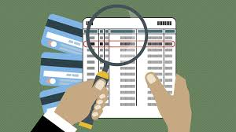
Table of Contents
Introduction
Fraud Detection
Fraud detection process
Technologies used
Types of Machine learning
Algorithm used
Objectives of the project
Data flow diagram
Dataset
Architecture Diagram
Required libraries and framework
Creating web app
Testing
Advantages and Disadvantages
Conclusions and Future Scope

Slide 3
Introduction
The online shopping growing day to day. Credit card are used for purchasing goods and services with the help of virtual card and physical card whereas virtual card for online transaction and physical card for offline transaction.
In a physical card based purchase, the cardholder presents his card physically to a merchant for making a payment. If the card holder does not realize the loss of card, it can lead to a substantial financial loss to the credit card company.
In online payment mode, attackers need only little information for doing fraudulent transaction(secure code, card number,expiration date etc.)

Slide 4
Fraud Detection
Credit card fraud detection techniques used to recognize fraudulent credit card transactions so that customers are not charged for item that they did not purchases.
Fraud detection is a process of identifying fraudulent transaction.
Fraud detection is a topic which is applicable to many industries including banking and financial sectors, insaurances, government agencies, and low inforcement and more.

Slide 5
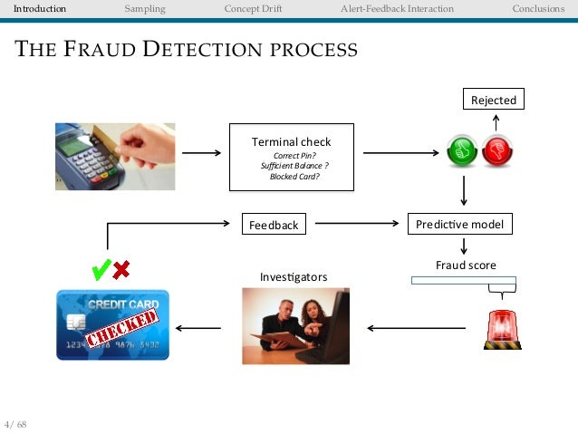
Fraud detection process
Fig. Fraud detection process

Slide 6
Technologies used
Machine learning
Machine learning is the scientific study of algorithms and static model that computer system use in order to perform a specific task .
Machine learning algorithms build a mathematical model based on sample data ,known as training data in order to make prediction and decisions.

Slide 7
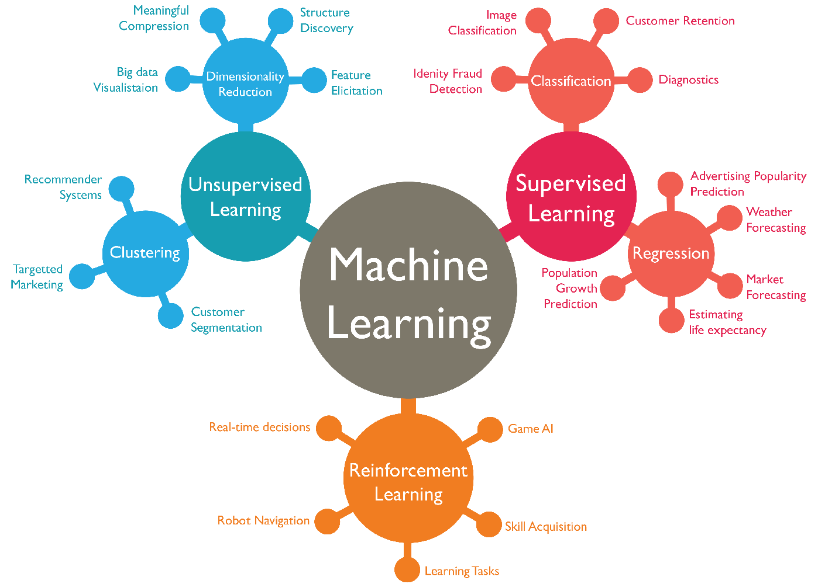
Types of machine learning algorithm

Slide 8
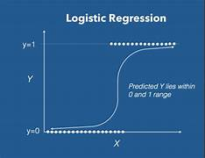
Algorithm used
Logistic regression: It is a statistical model that in its basic form uses a logistic function to model a binary dependent variable, although many more complex extensions exist.

Slide 9
Objectives of the project
Early detection
Accuracy
Real time monitoring
Risk assessment
Adaptive learning
Cost effectiveness

Slide 10
Data flow Diagram
COLLECTION OF DATA
PRE- PROCESS THE DATA
CREATE A PERFECT DATA
APPLY MACHINE LEARNING ALGORITHM
TRAINING THE DATA
TESTING THE DATA
GET THE OUTPUT

Slide 11
Dataset for credit card Fraud Detection
The dataset that is used for credit card fraud detection is derived from the Kaggle.
Kaggle is the online community of data scientist and Machine learners.
Kaggle allows users to find and publish data sets, explore and build models in a web- based data science project and solve challenges.

Slide 12
ARCHITECTURE DIAGRAM
INCOMING TRANSACTION
Logistic regression
FEATURE
EXTRACTION
CUSTOMER
TRANSACTION DATABASE
ALGORITHM OUTPUT
FRAUDULENT
TRANSACTION
LEGITIMATE
TRANSACTION
MESSAGE TO BANK
ALLOW TRANSACTION

Slide 13
Required Libraries and framework
The libraries required for this project are
1 : Numpy
2 : Pandas
3 : SKLearn
4 : Pickle
The framework required for this project are
Flask

Slide 14

Numpy
• NumPy stands for Numerical
Python.
• NumPy is a Python library used for working with arrays.
• It also has functions for working in domain of Linear algebra, fourier
transform, and matrices.

Slide 15

Pandas
• Pandas is a Python library used for
working with data sets.
• It has functions for analyzing,
cleaning, exploring, and manipulating
data.
• Pandas allows us to analyze big data
and make conclusions based on
statistical theories.

Slide 16

Sklearn
• Scikit-learn is probably the most
useful library for machine learning
in Python.
• The sklearn library contains a lot of
efficient tools for machine learning
and statistical modeling
• sklearn is used to build machine
Learning models.It should not be
used to manipulate data

Slide 17

Flask
Flask is often referred to as a microframework.
Flask is a web framework that allows developers to build lightweight web applications quickly and easily with Flask Libraries.
It is designed to keep the core of the application simple and scalable.

Slide 18
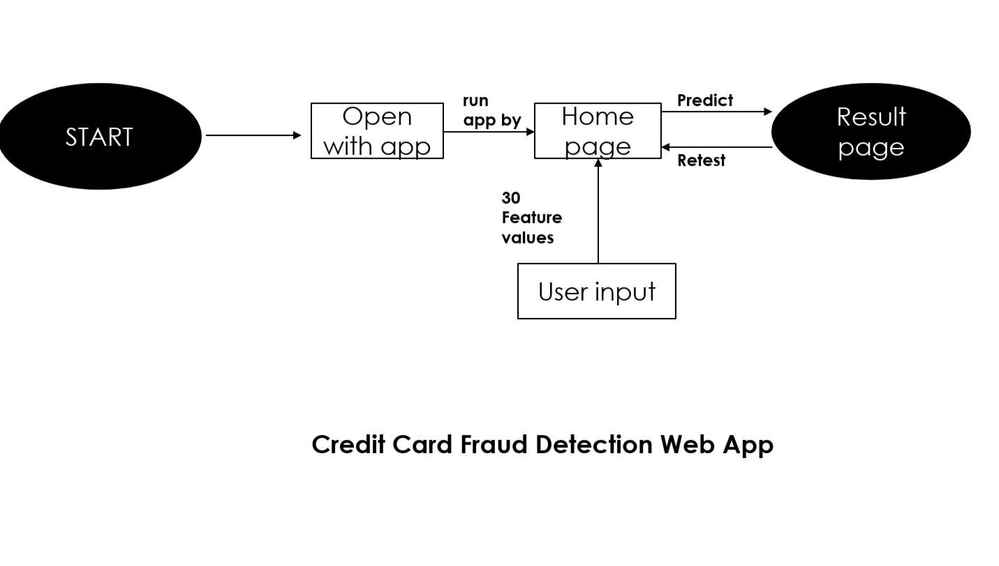
Creating Web App

Slide 19
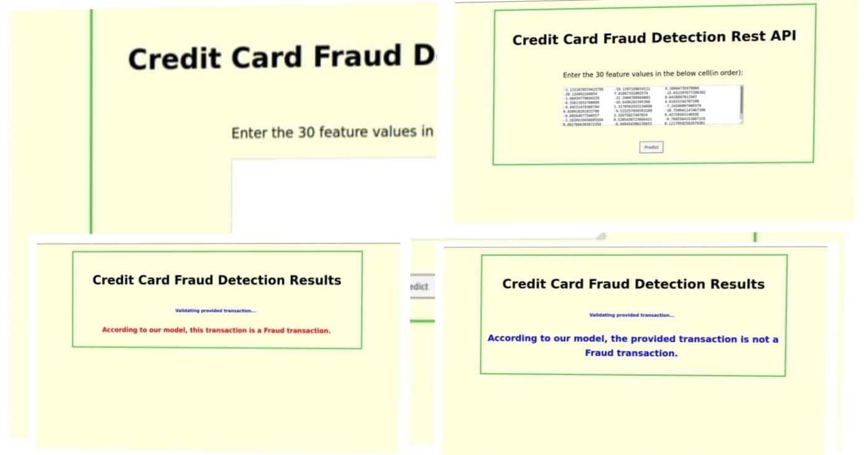
Sneak peak into our Web App

Slide 20
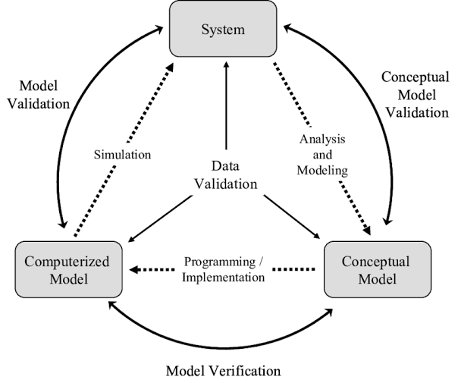
Testing
TESTING AND VALIDATION
Validation is complex process with many possible variations and options, so specify vary from database to database.

Slide 21
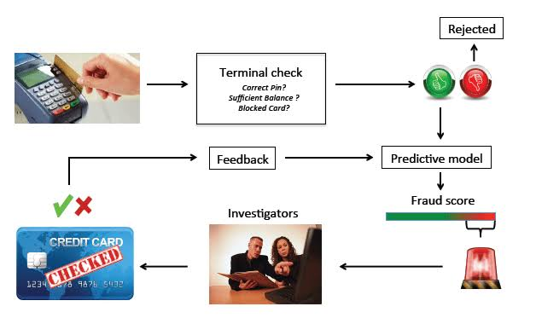
Levels of testing
Functional Testing
Non-functional Testing
White box Testing
Different stages of testing
Unit Testing
Integration Testing
System Testing
Acceptance Testing

Slide 22
Advantages of Credit card fraud detection
Reduces fraud risks
Improves customer service
Timely notifications
Secure environment

Slide 23
Disadvantages of Credit card fraud detection
False alarm notifications
Cost
Risk of identity theft
Unintended consequences

Slide 24
Conclusion
Credit Card is a great tool to pay money easily, but as with all the other monetary payment tools, reliability is a issue here too as it is subjected to breach and other frauds.
Transactions beforehand in future will be very easy.
Machine Learning can help producing great results if
provided enough amount of data.

Slide 25
Future Scope
Credit card fraud detection can benefit greatly from the application of advanced machine learning and artificial intelligence techniques.
Real-time monitoring of credit card transactions is essential to detect and prevent fraud as quickly as possible.
The future of credit card fraud detection projects lies in leveraging advanced technologies, data analytics.

Slide 26
THANKS

